Slide 1
STATISTICAL INFERENCE
Second Lab

Slide 2
Lab Agenda
Accessing Data Frames with logical And\OR
Control Statements
Functions
Workspace
Data Import and Export with R

Slide 3
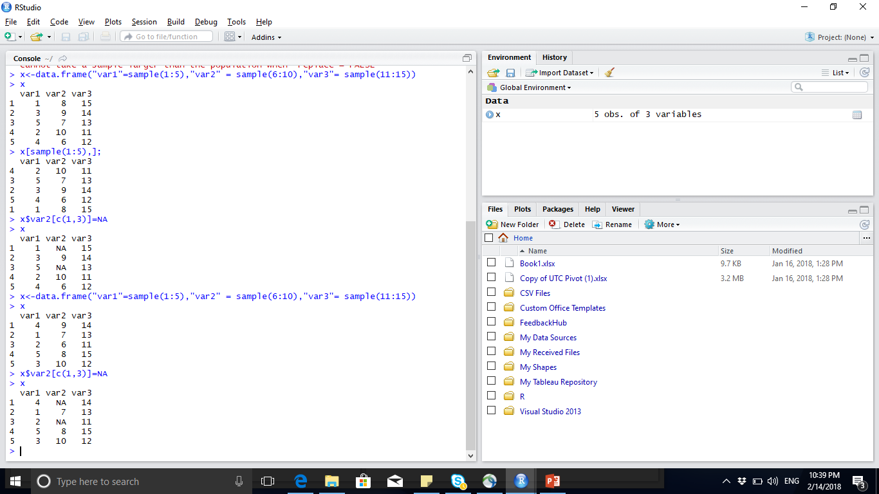
Data Frame – cont--

Slide 4
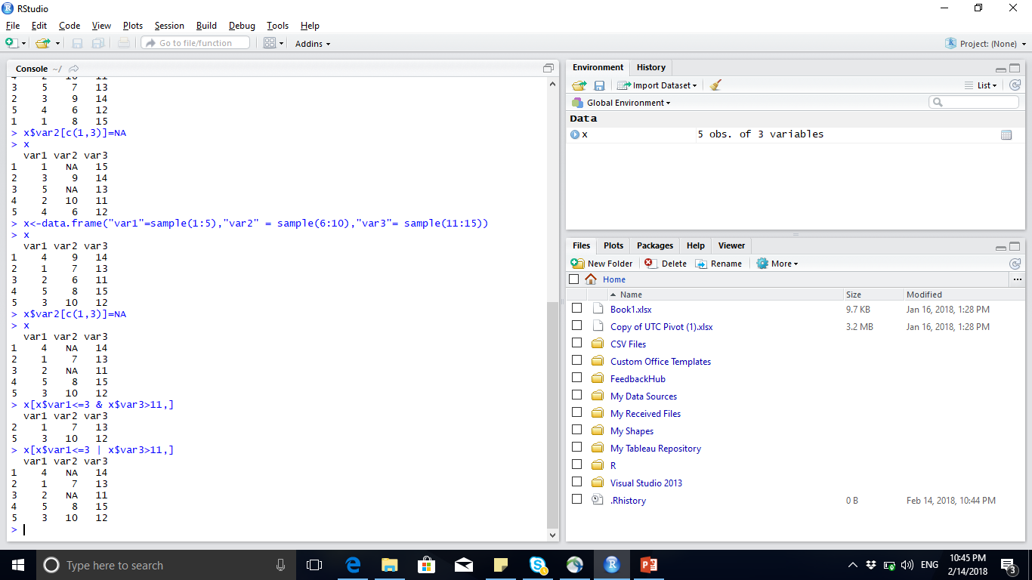
Logical And , OR
Notes:
X [x>3] 🡪 retrieve all values >3

Slide 5
Control Statements
if ... else ...
for loops
While loop

Slide 6

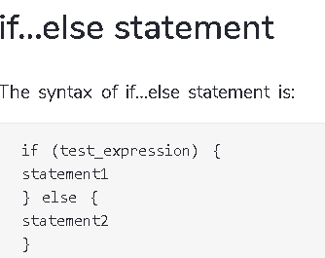
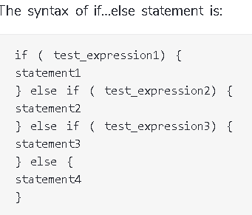
If … else …
Operators && or || or != may be used
Conditional execution of code

Slide 7
If … else …
> y<-5
>if (y>0)
{print (”y postive”)}
[1] ”y is postive”
> x<- 3
>if (x != 4)
{ x <- x+4}
else {x}
>x
[1] 7
> z <- 0
>if (z < 0 )
{print (”z negative”)}
else if (z > 0)
{print (”z positive”)}
else {print (”z is zero”)}
[1] ”z is zero”

Slide 8

for
Loops are used in programming to repeat a specific block of code.
A for loop is used to iterate over a vector in R programming.

Slide 9
for
> x<- 0
>for (i in 1:20)
{ x <- x + 1}
>x
[1] 20
> x<- 1
> y<- c(1,2,3,4)
>for (i in y)
{ x <- x + i;}
>x
[1] 11

Slide 10
while
while (expr_1) expr_2 While expr_1 is true, repeatedly evaluate expr_2
break and next statements can be used within the loop

Slide 11
while
>while (x!=60)
{ x <- x+1}
> X
[1] 60
> i<- 1
> while (1<6)
{ print(i)
i<- i+1
}
[1] 1
[1] 2
[1] 3
[1] 4
[1] 5
Notes:
Where is the initialization of “X”

Slide 12
Function Definition
Arguments can be assigned default values: arg_name = expression
Return value is the last evaluated expression or can be set explicitly with return()
function.name <- function(arg1, arg2, ...)
{ computations on the arguments some other code }

Slide 13
Function Examples
>square <- function(x = 10) {x * x}
> square() [1] 100 > square(2)
[1] 4
square <- function(x) {x * x}
> square()
Error in square() : argument "x" is missing, with no default
Notes:
X= 10 🡪 assignemet operator (<- ) can’t be used here

Slide 14
Function Examples
>intsum <- function(from=1, to=10) { sum <- 0 ; for (i in from:to) sum <- sum + i; sum;}
> intsum(3) # use default values
[1] 55
> intsum(3) # Evaluates sum from 3 to 10
[1] 52
> intsum(to=3) ... # Evaluates sum from 1 to 3 ...
[1] 6

Slide 15
Return in Functions
>intsum <- function (from=1, to=10)
{ sum <- 0 ;
for (i in from:to)
sum <- sum + i;
return(sum); }
> intsum()
[1] 55
> s <- intsum()
> s
[1] 55

Slide 16
Hands On
Create a Function that takes two arguments (x, y) and returns the “X” to the power of “Y”
ex: Power(2,3) returns 8 default return value is 1.
Notes:
Answer:
Exp <- function(x=1,y=1)
{ z=1; for(i in 1:y) z<-z*x; return(z);}

Slide 17
Some Notes on Functions
You can print the arguments for a function using args() command
> args(intsum)
function (from = 1, to = 10)
You can print the contents of a function by typing only function name, without the ()
You can edit a function using > n_intsum <- edit(intsum)

Slide 18
Debugging Functions
Toggle debugging for a function with debug()/undebug() command
With debugging enabled, R steps through function line by line
> debug(intsum)
> intsum(10)
Use print() to inspect variables along the way
Press <enter> to proceed to next line

Slide 19
Workspace
The workspace is your current R working environment
During an R session, all objects are stored in a temporary, working memory
list objects
ls()
remove objects
rm(name of the object you want to delete)
objects that you want to access later must be saved in a “workspace”
from the menu bar: File->save workspace
from the command line: save(x,file=“MyData.Rdata”)
Notes:
Does we save the variable x only

Slide 20
Prepare Working Directory
The working directory is the default location where R will look for files you want to load and where it will put any files you save.
>getwd()
>setwd(“path of the data set”)

Slide 21
Data Import and Export with R
Read data from and write data to
CSV files
EXCEL files
ODBC databases

Slide 22
Read and Write Data from csv file
>var1 <- 1:5
>var2 <- (1:5)/10
>var3 <- c("R", "and", "Data Mining", "Examples", "Case Studies")
>df1 <- data.frame(var1, var2, var3)
>names(df1) <- c("VarInt", "VarReal", "VarChar")
# save to a csv file
>write.csv(df1, “dummmyData.csv", row.names = FALSE)
# read from a csv file
>df2 <- read.csv("dummmyData.csv")
>print(df2)
Note : Check the working directory and ensure that you have write access to that directory.
You can check this with getwd() ;
Notes:
## VarInt VarReal VarChar
## 1 1 0.1 R
## 2 2 0.2 and
## 3 3 0.3 Data Mining
## 4 4 0.4 Examples
## 5 5 0.5 Case Studies

Slide 23
Practice: Read and Write Data from Excel file
>install.packages(“xlsx”)
>library(xlsx)
>write.xlsx(df2, “dummmyData.xlsx”, sheetName = "sheet1", row.names = F)
>df3 <- read.xlsx(“dummmyData.xlsx”, sheetName = "sheet1")
>df3
Notes:
If the package is not installed , do not practice just let them know the function name

Slide 24
Read from Database
Package ODBC: provides connection to ODBC databases.
Function odbcConnect(): sets up a connection to database
sqlQuery(): sends an SQL query to the database
odbcClose() closes the connection.
Notes:
No practice here , just let them know the function names

Slide 25
Practice: Read from Database
>install.packages("odbc")
>library(“odbc”)
>db <- odbcConnect(dsn = "servername", uid = "userid",pwd=“”)
>sql <- "SELECT * FROM lib.table WHERE ..."
>myData <- sqlQuery(db, sql)
>odbcClose(db)
Notes:
Functions sqlFetch(), sqlSave() and sqlUpdate(): read, write or update a table in an ODBC database

